Slide 1
Erythrocyte Polymorphisms and malaria
Evolution of Sickle Cell Disease

Slide 2

10 year old Haitian girl
Goes to clinic with severe chest pain
Many visits for joint pains & exhaustion
Labeled a hypochondriac
Blood count revealed low rbcs

Slide 3
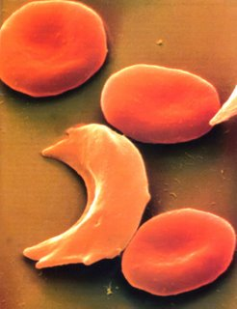
Blood smear

Slide 4
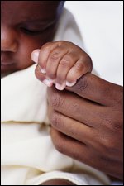
Sickle Cell Disease
70 million Americans have Sickle Cell Disease
2 million are carriers of Sickle Cell Trait
Most have SubSaharan African Ancestry
1 in 12 African Americans has Sickle Cell Trait

Slide 5
Sickle Cell Disease
Catastrophic disease of children
Attacks occur when oxygen levels in blood drop
Red blood cells deform & assume sickle shape
Sickle cells tend to trap other blood cells, cause “sludging”.
Severe sludging deprives tissues of oxygen and can kill muscle and bone.

Slide 6
Sickle cell disease – Why?
Proximate hypothesis?
Ultimate hypothesis?

Slide 7
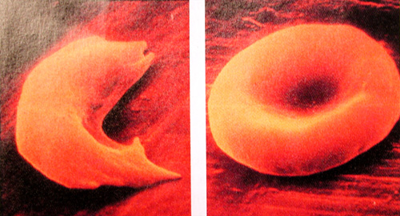
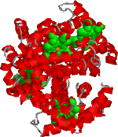
Hemoglobin

Slide 8
Hemoglobin
Oxygen transport –
Picks up oxygen from the pulmonary veins – drops off oxygen in tissues and capillary beds
Contains iron
Red blood cells

Slide 9
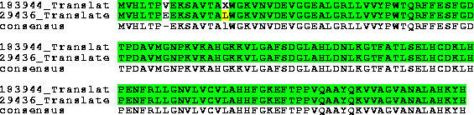
Mutation of Beta Hemoglobin

Slide 10
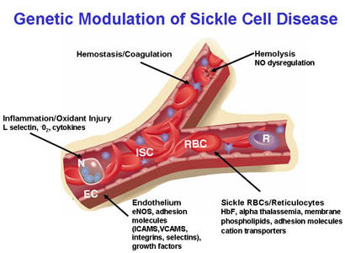
Blockage of circulation

Slide 11
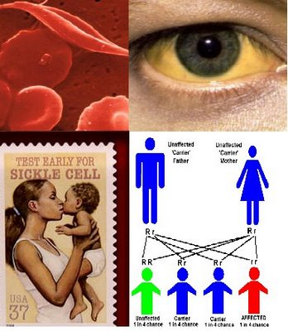
Human Variation
HbAA – homozygote “normal hemoglobin”
HbAS – heterozygote sickle cell trait
HbSS – homozygote sickle cell

Slide 12
Inheritance
Sickle Cell is inheritence is autosomal recessive
Hb AA
Hb AS – usually no symptoms
Hb SS – manifests as sickle cell disease

Slide 13
Sickle Cell Disease
High Mortality:
Males with HbSS Age 42 years
Females with HbSS Age 48 years
Anemia
Chest Pain
Stroke
Susceptibility to Bacterial Infections

Slide 14
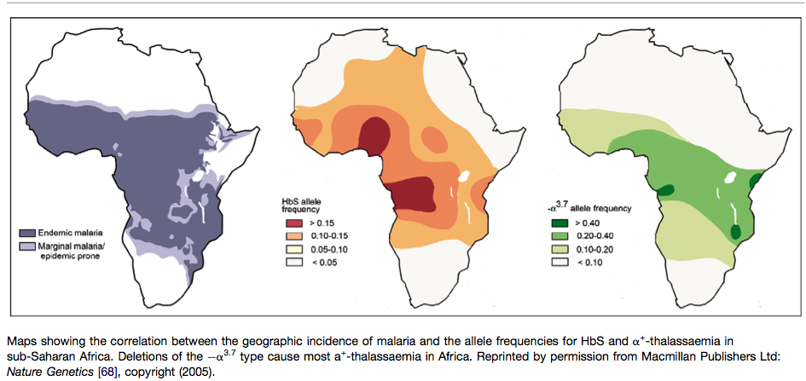
Geography

Slide 15
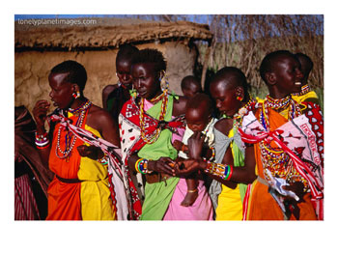
Geography
SCD occurs in places with malaria
First described in southern Italy
Then noticed in subsaharan Africa
Sickle cell trait absent in places like Kenyan highlands where mosquito and malaria absent

Slide 16
Balanced Polymorphism
Hb AS – Benefit in Malaria?
Heterozygous advantage.
In Malarial regions: HB AS better survival than HB AA or HB SS.

Slide 17
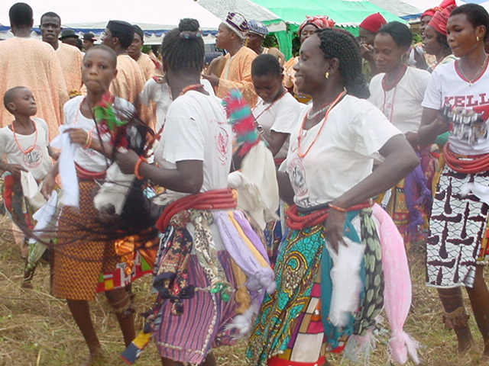
Another Case
January 2006, a US family of 5 kids visit Nigeria
Pre-trip: pediatrician gives antidiarrheals only
No chemoprophylaxis
3 kids all given Fansidar for fever during trip.
Kids felt better

Slide 18
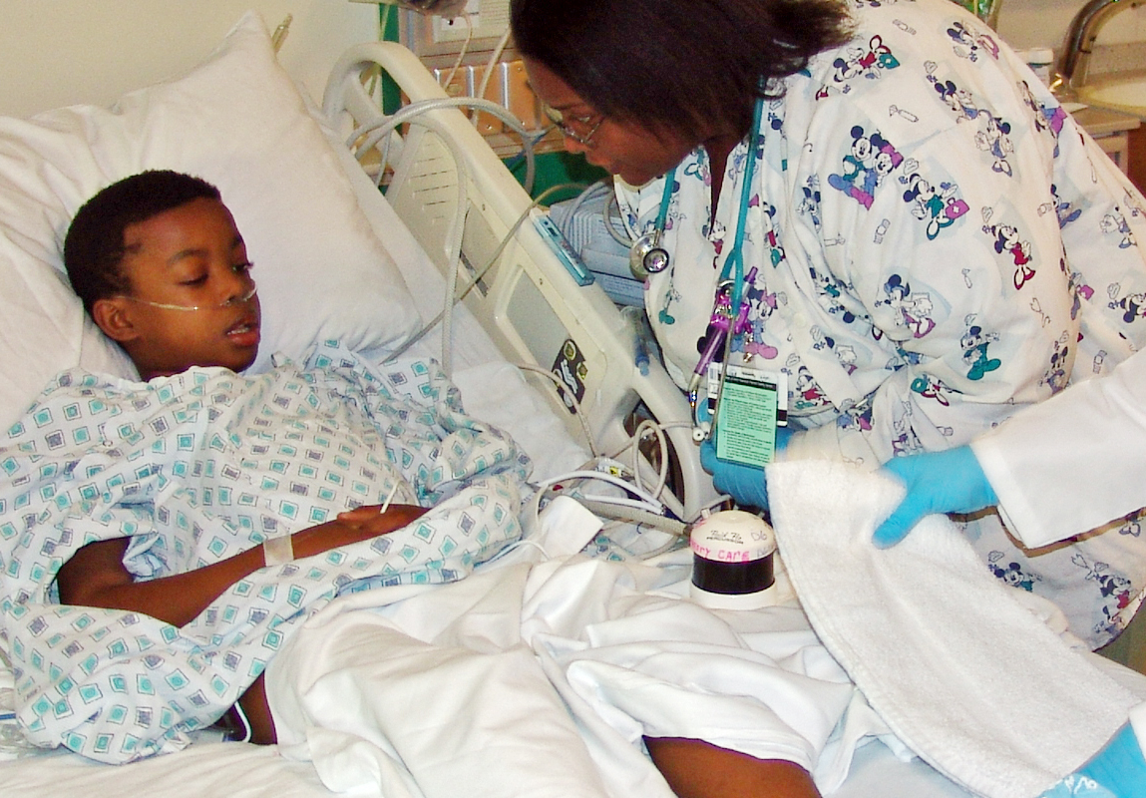
3 had return of fever in US
Diagnosed with flu
Given antibiotics at the local clinic
Then they got sicker
Mom notices 1 child is very weak and has yellow eyes!

Slide 19
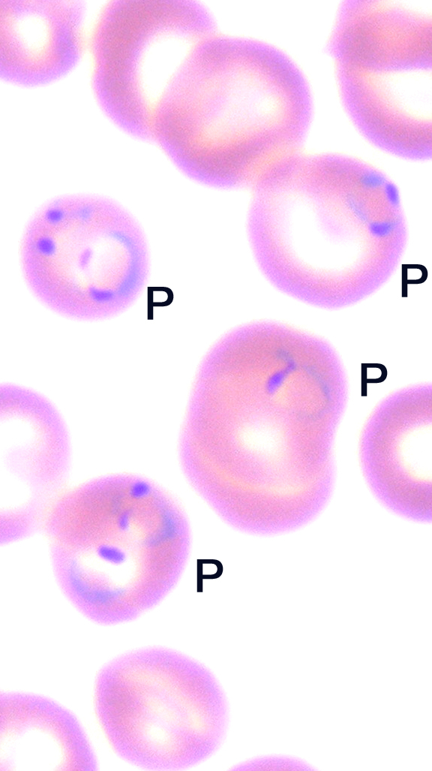
Yellow Kid
Yellow pupils
Anemic
Low Blood Sugar
1 in 20 rbcs parasitized
Placed on Ventilator
Transfused
All 5 kids tested pos for falciparum malaria

Slide 20
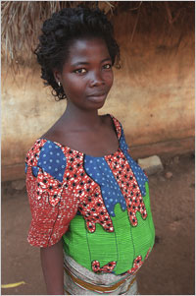
Malaria
400 million cases worldwide
Malaria kills 1,500,000 yearly
Young children and pregnant women
Immunity partial, not durable
30,000 travelers: preventable illness

Slide 21
Malaria Vector & Pathogen
Female Anopheles - Crepuscular hours.
Congenital and transfusion - related cases
Autochthonous: single mosquito transmits disease from 1 human to another

Slide 22
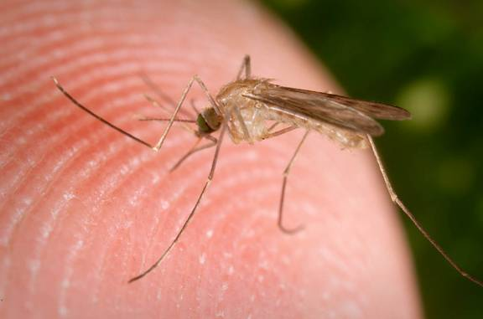

Slide 23
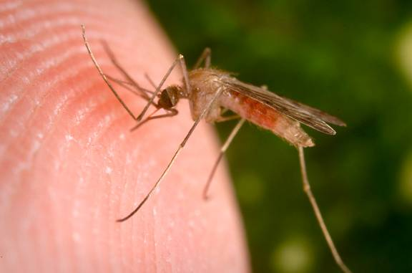

Slide 24
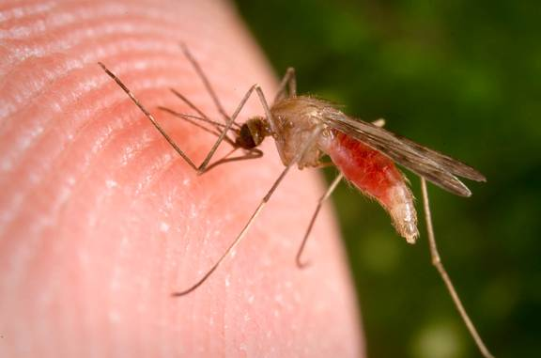

Slide 25
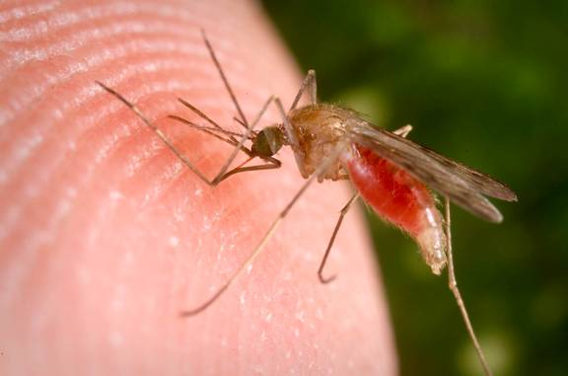

Slide 26
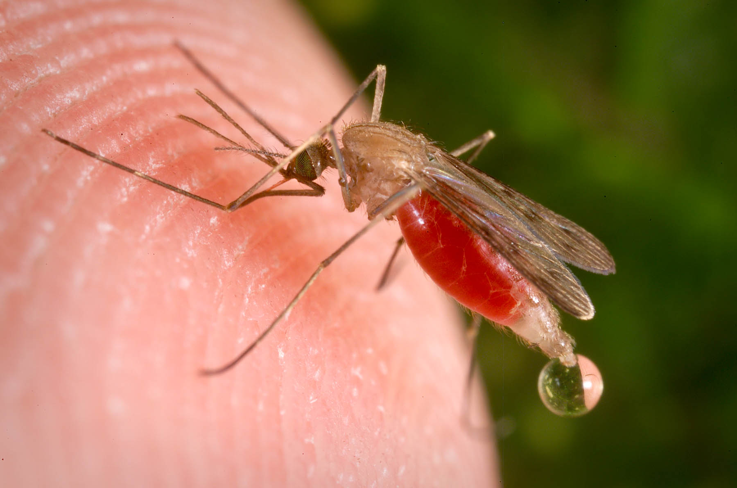

Slide 27
Severe Malaria
Cerebral malaria: seizures, coma
Severe anemia, red cells burst
Hemoglobin in urine
Fluid in lungs
Loss of platelets
Cardiovascular collapse and shock
Blood becomes acidic

Slide 28
Malaria Pathogenesis
Malaria parasites digest RBC proteins and use glucose to lactic acid as energy, thus hypoglycemia & acidosis.
Injure RBC membrane: hemolysis, splenic clearance & anemia.
Makes blood cells sticky - obstruct microcirculation
Low platelets - splenic sequestration

Slide 29
HbSS
Full blown sickle cell disease
Increased mortality from sickle cell attacks.
In locations like Chicago, with no malaria, this genetic polymorphism would be subject to negative selection.
What about in coastal Kenya?

Slide 30
HbAS
Admitted to hospital less in malarious regions
Die less often than HbAA in malarious regions
Protect against severe malaria infection
Infected rbcs sickle 40 times more readily than non infected cells
Decreased parasite reproduction
Increased clearance from the population.

Slide 31
Selection for HbAS
Outweighs negative selection for HbSS
Maintains HbS allele in population
Frequency of allele is dependent on presence of malaria
Balanced polymorphism

Slide 32
So how does HbAS protect against malaria?
Evolutionary hypothesis can lead to insights into the proximate mechanisms of disease.
Physiology and pathophysiology intersect…

Slide 33
Malaria: Sickle trait promotes removal of parasites!
HbSS without malaria:
Cells sickle – cause obstruction of microcirculation
Anemia - Sickled cells have enhanced removal from circulation
Increased phagocytosis Increased oxidative stress on rbc membrane
Sequestration of abnormal rbcs
HbAS and Malaria:
Cells sickle – cause obstruction of microcirculation
Anemia - Sickled cells have enhanced removal from circulation
Increased phagocytosis
Increased oxidative stress on rbc membrane
Sequestration of abnormal rbcs

Slide 34
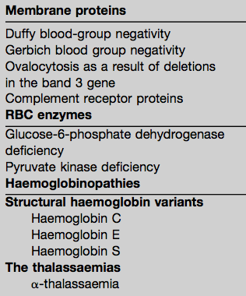
Other polymorphisms that may protect against malaria

Slide 35
Language
Compare:
Red blood cell defects and malaria
  Mol Biochem Parasitol. 2006 Oct;149(2):121-7. Epub 2006 Jun 9
Erythrocyte variants and the nature of their malaria protective effect
Cellular Microbiology 7 (6): 753-763 2005
Host defenses or pathogen virulence factors?

Slide 36
Genes that cause disease
If they are common, they probably have some current or historical selective pressure that keeps them around
Deleterious mutations occur at rates 1:50,000
Some genes are very frequent e.g. 20% of population or more: raise questions

Slide 37
Summary
Malaria – sickle cell trait is a balanced polymorphism
Genetic polymorphisms ask evolutionary question – what selective pressure or benefit keeps them in population
Frequency of polymorphism is a clue

